Slide 1
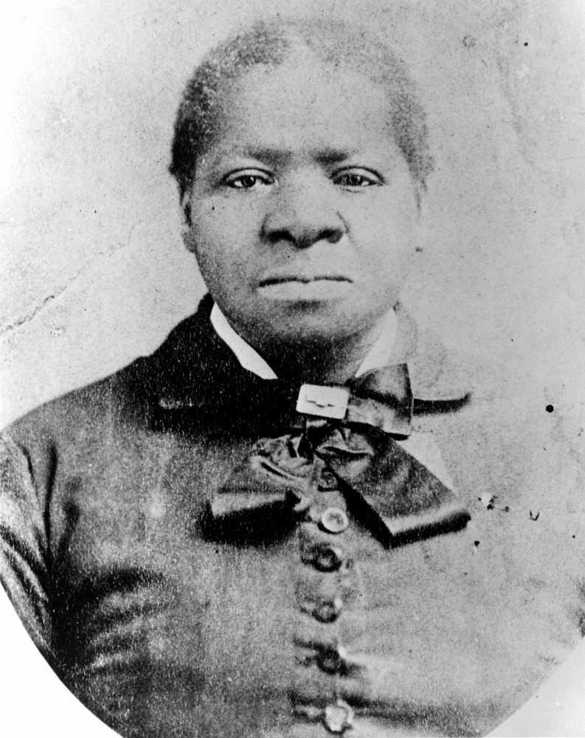
Downtown LA Neighborhood Council
Los Angeles City Council District 14
Biddy Mason Charitable Foundation
BASE Innovation Hub
Present
JUNETEENTH FEST 2026
Honoring Biddy Mason
A Cultural Activation
Friday, June 19, 2026 · Biddy Mason Memorial Park · Downtown Los Angeles
"From Enslaved to Landowner. From Survivor to Philanthropist. Her Legacy Lives in Every Block of This City."

Slide 2
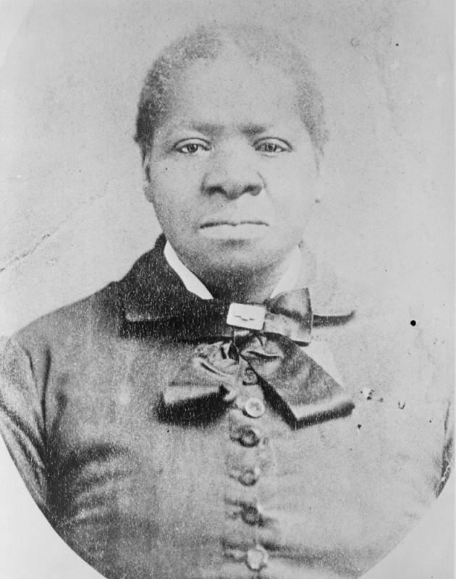
HER STORY
Bridget 'Biddy' Mason
1818 – 1891 · Nurse · Midwife · Landowner · Philanthropist
Born into slavery in 1818, Biddy Mason walked over 1,700 miles from Mississippi
to California — on foot, herding livestock — as an enslaved woman.
In 1856, she petitioned the California District Court and won her freedom,
becoming one of the first Black women to successfully sue for liberty in the state.
She settled in Los Angeles, worked as a nurse and midwife, and saved every penny.
By 1866, she purchased land at 331 S. Spring Street — the first Black woman
in Los Angeles to own property.
She founded the First African Methodist Episcopal Church (FAME) in Los Angeles
and used her wealth to feed the hungry, care for the sick, and bail out prisoners.
When she died in 1891, her estate was valued at $300,000 — nearly $10 million today.

Slide 3
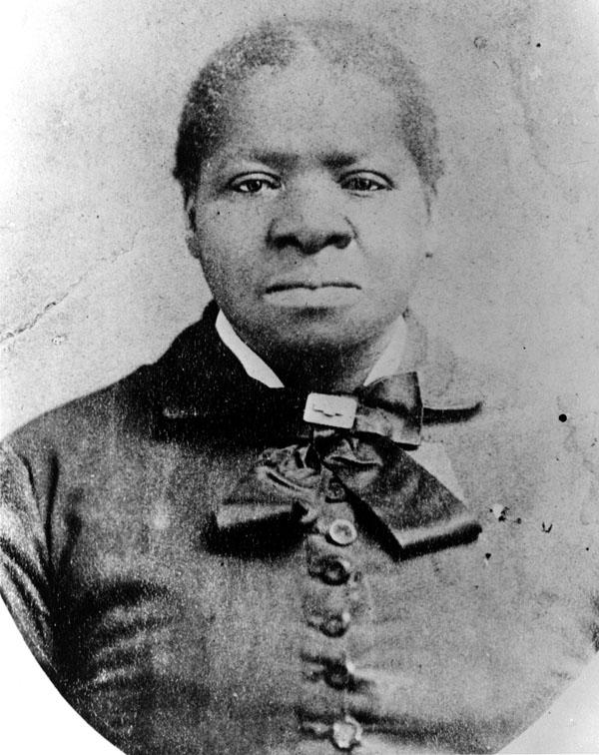
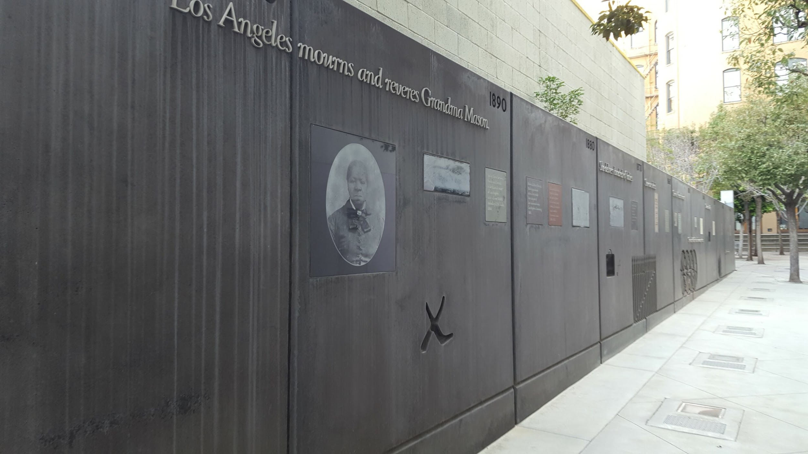
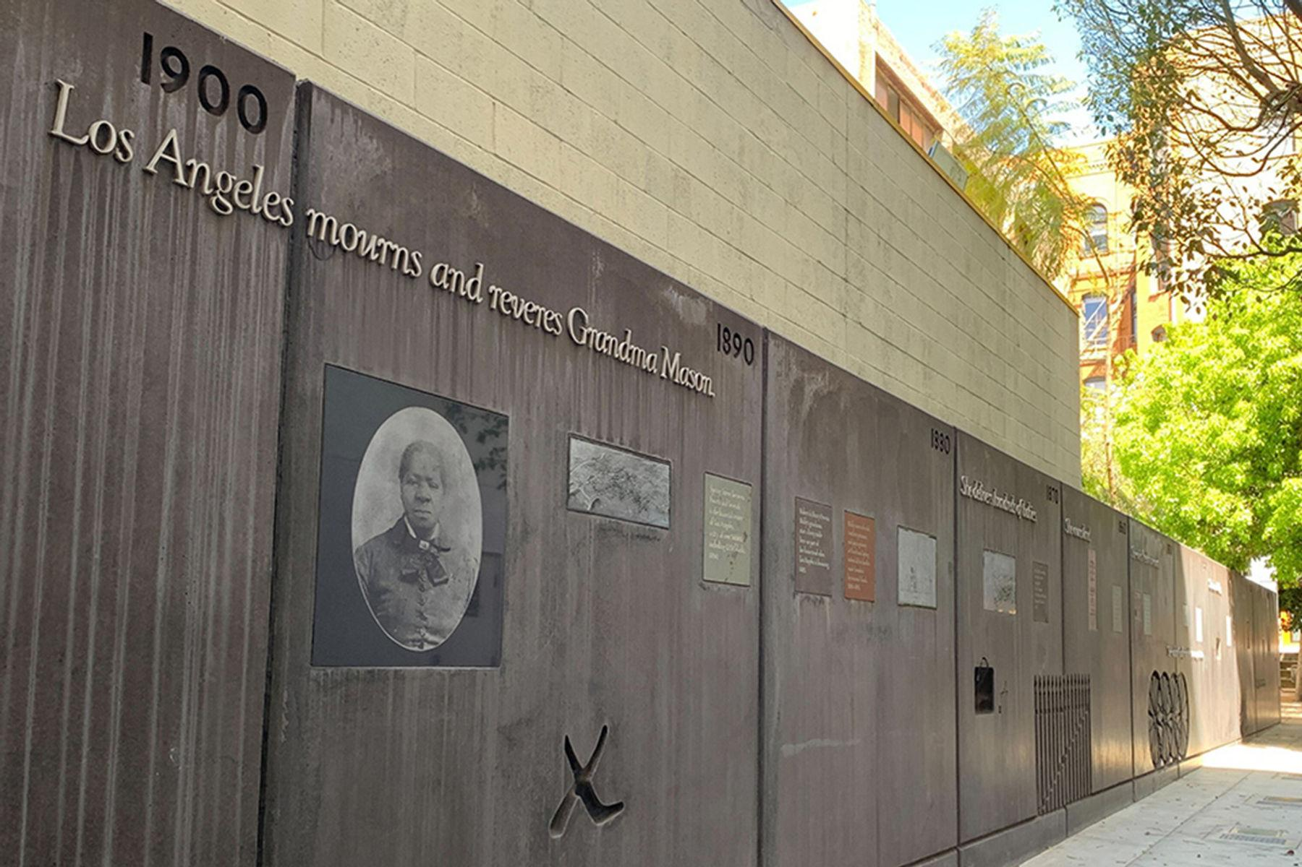
LEGACY TIMELINE
A Life of Defiance, Dignity & Determination
1818
1847
1856
1866
1872
1884
1891
Born into Slavery
Walked 1,700 Miles to CA
Won Her Freedom in Court
Bought Land on Spring Street
Founded FAME Church
Opened a Travelers Aid
Estate Worth $300,000

Slide 4
EXECUTIVE SUMMARY
Juneteenth Fest 2026
500+
Expected Attendees
A District-Wide Cultural, Economic & Innovation Activation
3
Activation Zones
Juneteenth Fest 2026 transforms a single-site park gathering into a multi-block
cultural corridor activation spanning Broadway from 3rd Street to 5th Street
in the heart of Downtown Los Angeles.
Centered at Biddy Mason Memorial Park — the site where she once owned land —
this activation honors the legacy of a woman who rose from enslavement to become
one of Los Angeles' most consequential figures.
The event integrates street closures, a vendor marketplace, immersive historical
storytelling, vacant retail activation, live performance, and AI-powered innovation
— positioning DTLA as a national model for culture-led district revitalization.
2
Event Phases
8 hrs
Full Day Experience
June 19
Juneteenth 2026
DTLA
Downtown Los Angeles

Slide 5
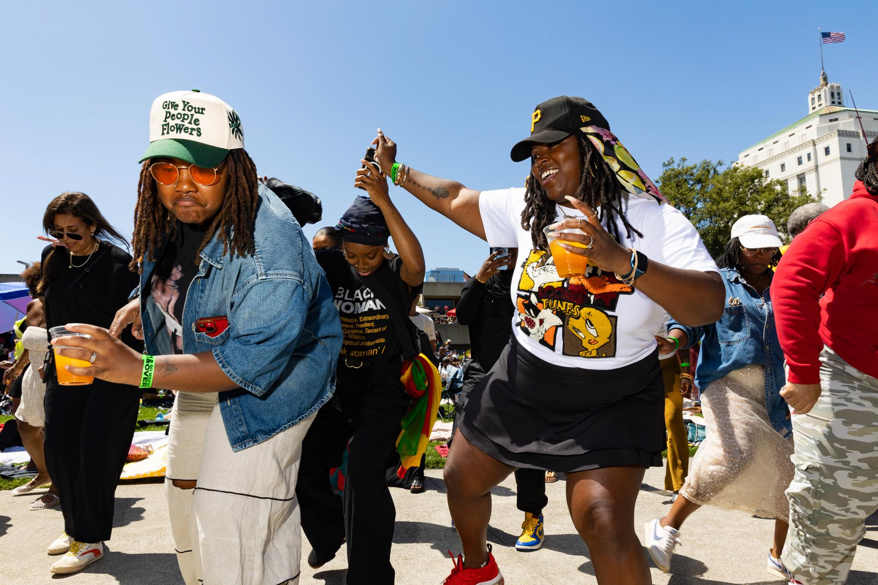
MISSION & PURPOSE
Why This Matters
Honor
Preserve and elevate the legacy of Bridget 'Biddy' Mason — a woman who defied every system designed to hold her down.
Activate
Transform dormant commercial corridors into vibrant, Black-led cultural and economic spaces.
Empower
Support Black-owned businesses, local entrepreneurs, artists, and community organizations.
Innovate
Introduce technology-enabled storytelling, AR experiences, and digital archiving to preserve Black history.
Unite
Build bridges between community, city leadership, corporate partners, and the next generation.
Scale
Establish a replicable national model for culture-driven urban district activation.

Slide 6
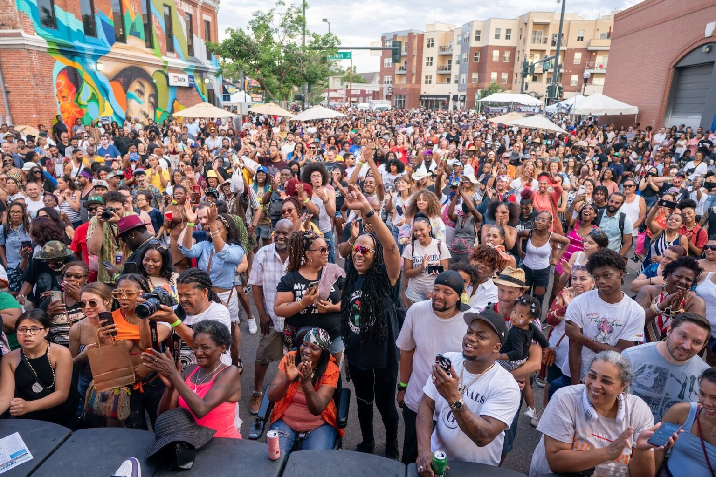
EVENT OVERVIEW
Juneteenth Fest 2026
DATE
Friday, June 19, 2026
LOCATION
Biddy Mason Memorial Park 333 S Spring St, Los Angeles, CA 90013
STREET CLOSURE
Broadway between 3rd & 4th Street
PHASE 1
12:00 PM – 4:00 PM Biddy Mason Park Experience + Broadway Activations
PHASE 2
4:00 PM – 8:00 PM Broadway Vendor Market + BASE Gallery + Music
ATTENDANCE
500+ DTLA Stakeholders & Community Visitors

Slide 7
ACTIVATION FOOTPRINT
Four Zones. One Corridor. Infinite Impact.
1
2
3
4
ZONE 1 — LEGACY
ZONE 2 — MARKETPLACE
ZONE 3 — PERFORMANCE
ZONE 4 — INNOVATION
Biddy Mason Park and / Broadway
3rd → 4th Street
4th Street
BASE Gallery
• Cultural programming at the park
• Historical storytelling & guided tours
• Biddy Mason Story Room installations
• Community resource activations
• Black-owned vendor booths
• Food, retail, art & wellness
• Community organizations
• Local DTLA entrepreneurs
• Main stage: music, spoken word
• Live art & cultural showcases
• Gospel, jazz & contemporary acts
• Youth & family programming
• BASE Innovation Hub programming
• Immersive /digital experiences
• Tech-enabled storytelling
• Content creation & live streaming

Slide 8
DEAD RETAIL ACTIVATION
"Biddy Mason Story Rooms"
Transforming Vacant Storefronts into Immersive Cultural Chapters
Chapter 1
Immersive projection mapping depicting Biddy's 1,700-mile journey from Mississippi to California.
The Walk to Freedom
Chapter 2
Interactive recreation of the 1856 freedom hearing — visitors hear the judge's ruling in real time.
The Courtroom
Chapter 3
AR overlay showing Biddy's Spring Street property and its transformation over 150 years.
The Land
Chapter 4
Tribute to her work as nurse and midwife — stories from the families she served.
The Healer
Chapter 5
Digital archive of her charitable acts, the FAME Church founding, and her enduring community impact.
The Philanthropist

Slide 9
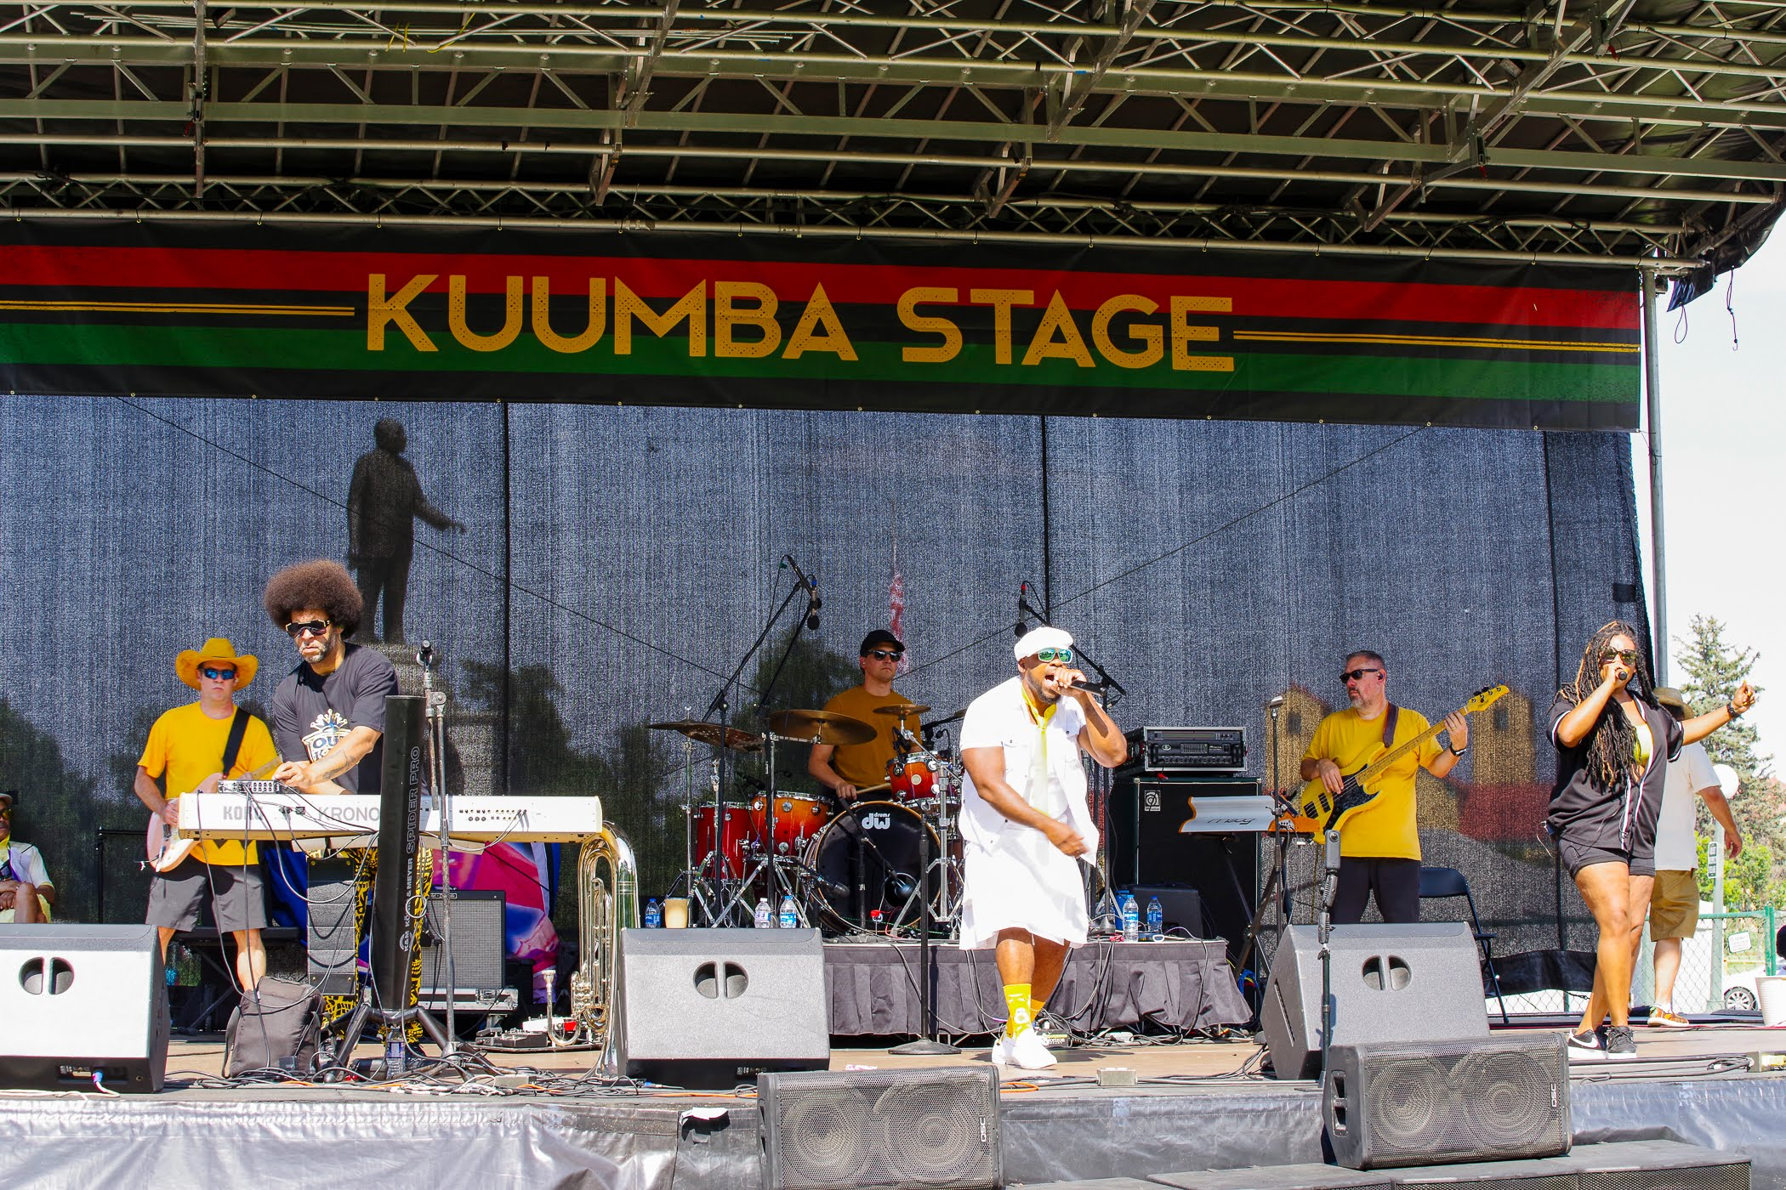
PROGRAMMING
Experience Design
CULTURAL PROGRAMMING
• Live music: Gospel, Jazz, R&B, Contemporary
• Spoken word & poetry performances
• Panel discussions with community leaders
• Youth & family engagement activities
EDUCATIONAL COMPONENTS
• Historical tours & guided narratives
• Panels on wealth, land ownership & legacy
• Black entrepreneurship workshops
• Biddy Mason Story Room experiences
EXPERIENTIAL ACTIVATIONS
• Live art installations & projection mapping
• Interactive storytelling environments
• QR/NFC-enabled digital experiences
• 3D asset capture & digital archiving

Slide 10
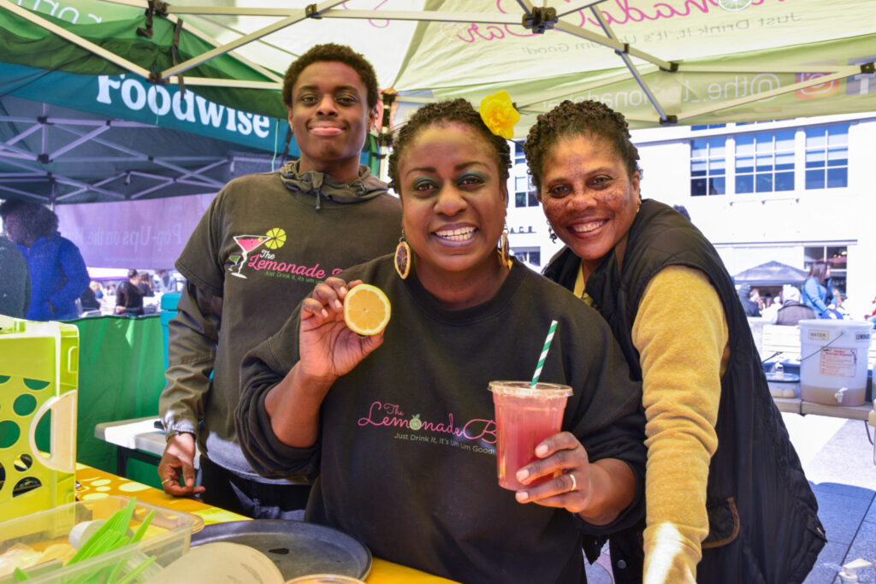
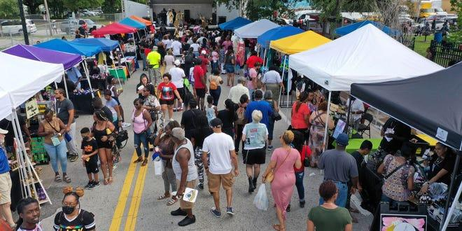
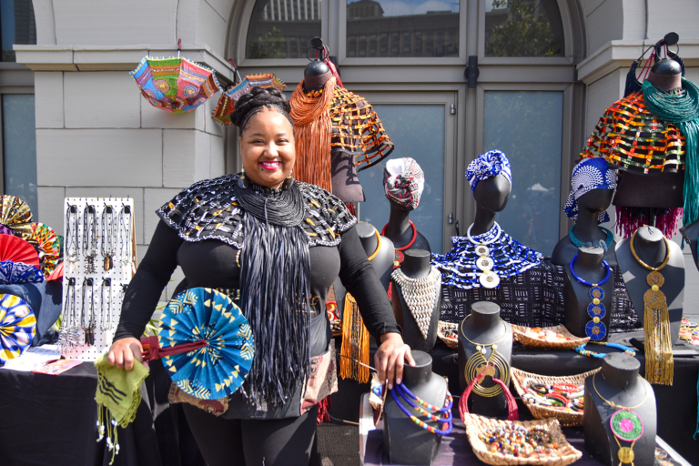
ECONOMIC ECOSYSTEM
Vendor Marketplace & Black Business Activation
Black-Owned Businesses
Food & Beverage
Art & Design
Priority vendor selection for Black entrepreneurs from DTLA and beyond.
Curated food operators featuring Black-owned restaurants and chefs.
Visual artists, designers, jewelers, and fashion creators.
Wellness & Health
Community Orgs
Tech & Innovation
Holistic health, beauty, and wellness practitioners.
Nonprofits, advocacy groups, and social service providers.
Startups, digital creators, and innovation-focused vendors.

Slide 11
TECHNOLOGY & INNOVATION
BASE Innovation Hub × Digital Experience Layer
Where Black History Meets the Future
QR / NFC Storytelling
Augmented Reality
Tap-enabled experiences throughout the corridor — each point unlocks a chapter of Biddy Mason's life.
AR overlays of Biddy Assets
3D Asset Capture
Live Streaming
Digital preservation of art installations, creating a permanent archive of the 2026 activation.
BASE Gallery serves as the content creation hub — broadcasting the event to global audiences.
Digital Marketplace
Vendor onboarding and digital commerce integration for Black-owned businesses.

Slide 12
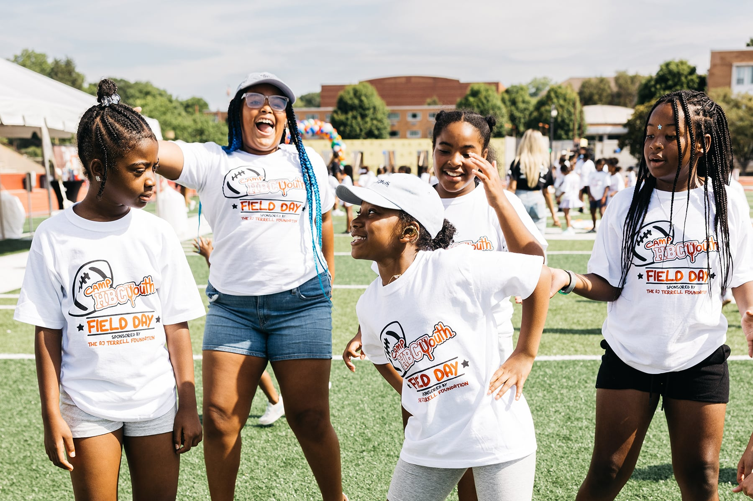
COMMUNITY & CITY IMPACT
Triple Bottom Line Impact
ECONOMIC IMPACT
• Increased foot traffic to Downtown LA
• Revenue for 50+ Black-owned vendors
• Activation of vacant retail spaces
• CRA-aligned financial opportunity
• Long-term corridor revitalization
CULTURAL IMPACT
• Preservation of Black history in LA
• Elevation of Biddy Mason's legacy
• Community education & engagement
• Intergenerational storytelling
• National model for Juneteenth activation
URBAN IMPACT
• Temporary-to-permanent activation model
• Support for DTLA Historic Core revival
• Demonstrates culture-led development
• City partnership & civic engagement
• Blueprint for future district activations

Slide 13
PARTNERSHIPS
Who We're Calling In
We are seeking collaboration and support from visionary partners who believe in culture as infrastructure.
CITY OF LOS ANGELES
CORPORATE SPONSORS
Mayor's Office · Cultural Affairs · LADOT · LAPD · Sanitation
Foundations · Financial Institutions · CRA-Aligned Partners
• Street closure permits
• Vendor & health permits
• Infrastructure support
• Civic endorsement
• Title & presenting sponsorships
• Programmatic collaboration
• Branded activations
• Media & PR amplification
PROPERTY OWNERS
COMMUNITY ORGS
DTLA Stakeholders · Retail Space Owners
· LA Commons · · Black Chambers
• Retail space activation
• Temporary use agreements
• Long-term corridor investment
• Adaptive reuse partnerships
• Programming collaboration
• Vendor & vendor recruitment
• Community outreach
• Cultural advisory

Slide 14
SPONSORSHIP OPPORTUNITIES
Invest in Legacy
Four tiers of partnership — each one a direct investment in Black culture, Black business, and Black history.
LEGACY
PIONEER
BUILDER
COMMUNITY
$25,000+
$10,000
$5,000
$1,000
• Title naming rights to the event
• Presenting sponsor on all materials
• Branded Story Room chapter
• VIP reception & speaking opportunity
• Full-stage logo placement
• Social media campaign integration
• Digital archive naming rights
• Co-presenting sponsor recognition
• Branded vendor marketplace zone
• Logo on stage backdrop & signage
• VIP access for 10 guests
• Social media feature package
• Program book full-page feature
• Supporting sponsor recognition
• Branded activation booth
• Logo on event signage
• VIP access for 5 guests
• Social media mention
• Program book half-page feature
• Community partner recognition
• Logo on digital materials
• 2 VIP passes
• Social media shoutout
• Program book listing

Slide 15
IMPLEMENTATION STRATEGY
Permitting, Logistics & Execution
PERMITS REQUIRED
PRODUCTION TIMELINE
• Street closure permits (LADOT)
• Vendor & health permits
• Temporary use of retail spaces
• Special event permit (City of LA)
• Sound & amplification permits
• Alcohol service permits (if applicable)
• 60 days out: Permits filed & approved
• 60 days out: Vendor applications open
• 45 days out: Programming confirmed
• 30 days out: Marketing campaign launches
• 14 days out: Site walk-through
• 7 days out: Final logistics review
• Day of: 6 AM setup, 12 PM doors open
CITY COORDINATION
INFRASTRUCTURE NEEDS
• LADOT — Traffic & street closure
• LAPD — Event security & crowd management
• LA Sanitation — Waste & cleanup
• LA Cultural Affairs — Programming support
• Mayor's Office — Civic endorsement
• Stage & sound production
• Tent & booth structures
• Power & electrical distribution
• Portable restrooms & sanitation
• Security barriers & crowd control
• Signage & wayfinding

Slide 16
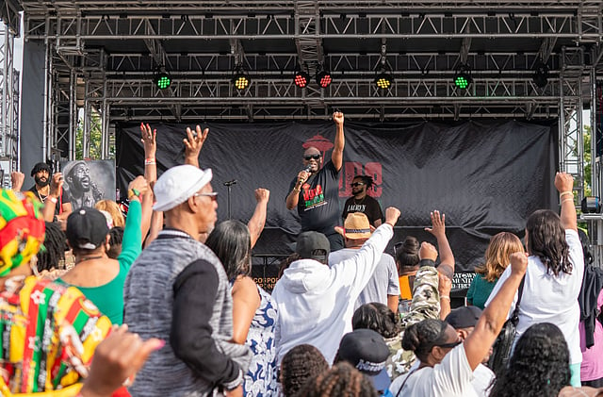
LONG-TERM VISION
Beyond June 19th
A Replicable National Model
Annual Juneteenth Fest
Establish Juneteenth Fest as a permanent annual activation in Downtown Los Angeles — growing in scale, impact, and national recognition each year.
Biddy Mason Cultural Corridor
Transform the Broadway corridor into a permanent cultural district honoring Black history, Black business, and Black innovation in DTLA.
National Replication Model
Package the activation model for deployment in other cities — a blueprint for culture-led urban revitalization anchored in Black history.
Digital Legacy Archive
Build a permanent digital archive of Biddy Mason's story, accessible globally through the technology infrastructure built at Juneteenth Fest 2026.
Economic Ecosystem
Develop a year-round Black business incubator and marketplace program seeded by the relationships and infrastructure built at the festival.

Slide 17
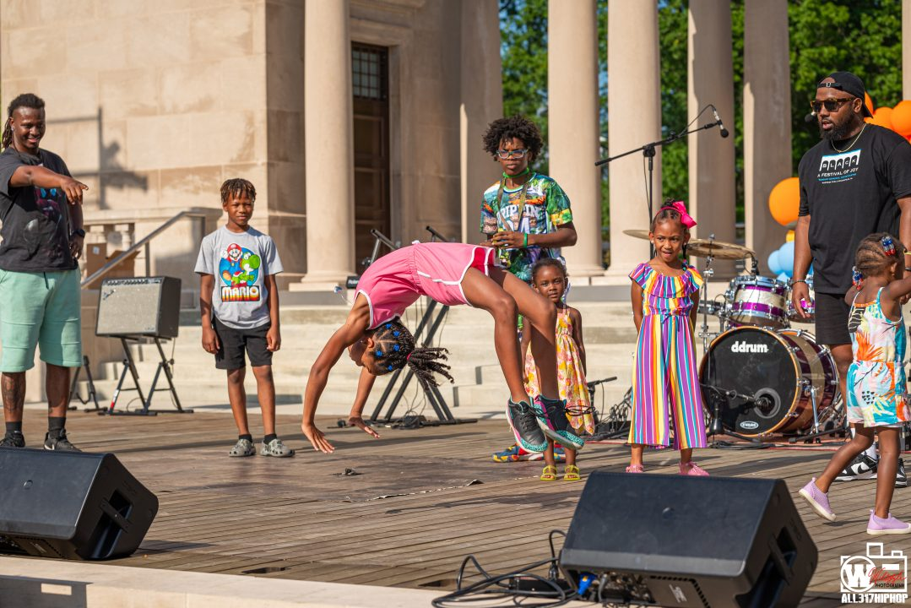
CALL TO ACTION
Join the Movement.
Be part of the most significant cultural activation in Downtown Los Angeles history.
· Flagship Juneteenth Celebration
· District-Scale Cultural Activation
· Economic Catalyst for Black LA
· National Model for Urban Revitalization
Partners: Biddy Mason Foundation · Downtown Los Angele Neighborhood Council · BASE Innovation Hub

Slide 18
JUNETEENTH FEST 2026
Biddy Mason Cultural Corridor Activation
Friday, June 19, 2026
Biddy Mason Memorial Park · 333 S Spring St, Los Angeles, CA 90013
Broadway from 3rd to 5th Street · 12 PM – 8 PM
"She didn't just survive. She built."
Downtown LA Neighborhood Council - Biddy Mason Foundation · BASE Innovation Hub · CD14

